Slide 1
Healthcare Internet Patient-Centered Care
By- Rimple Talati
Submitted on: 7th Dec,2014

Slide 2
Problem Statement
No single communication system available where hospital/clinics, doctors, patients, pharmacies and pharmaceutical companies can interact with each other.
Maintaining and accessing records of patients across the world is not easy to handle

Slide 3
Solutions to the problem
A communication network has been created through a single system between hospital/clinics, patients, doctors, pharmacies and pharmaceutical companies.
Saving the records of patient in hospital/clinics will help to retrieve it even in emergency conditions by sending the request to the admin.

Slide 4
Scope of project
This project is made in order to support health care of patient. It allows to create hospitals, pharmacies and pharmaceutical companies at a global level.
It ensures the safety of patients by showing medication guidelines from pharmaceutical companies, sending notifications to doctors and patients from pharmaceutical companies, facility to callback drugs from pharmacies and feedback by doctors and patients(REM).
It allows communication between doctors and patients.
It allows the facility to retrieve patient records whenever required.
Each patient can share their story to other patients about the disease that they encountered.

Slide 5
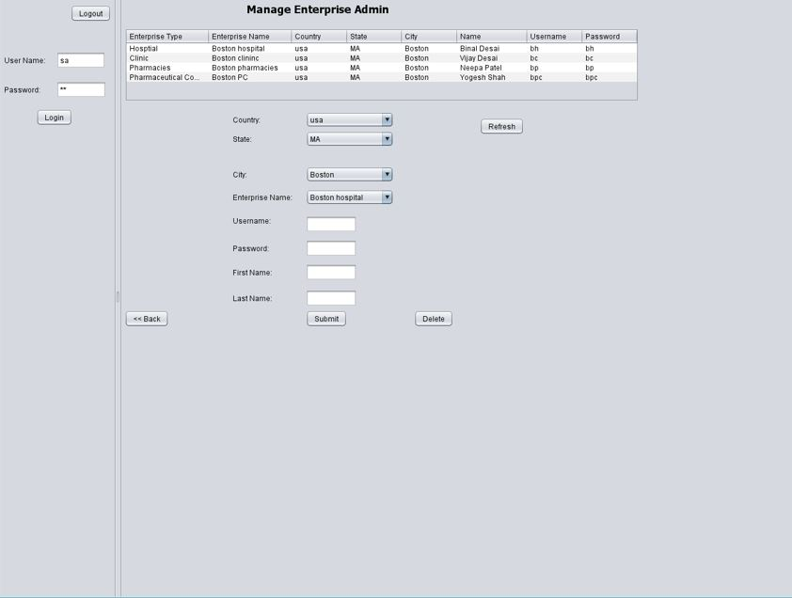
List of User Accounts of enterprise admin
System admin creates user account of different enterprises.

Slide 6
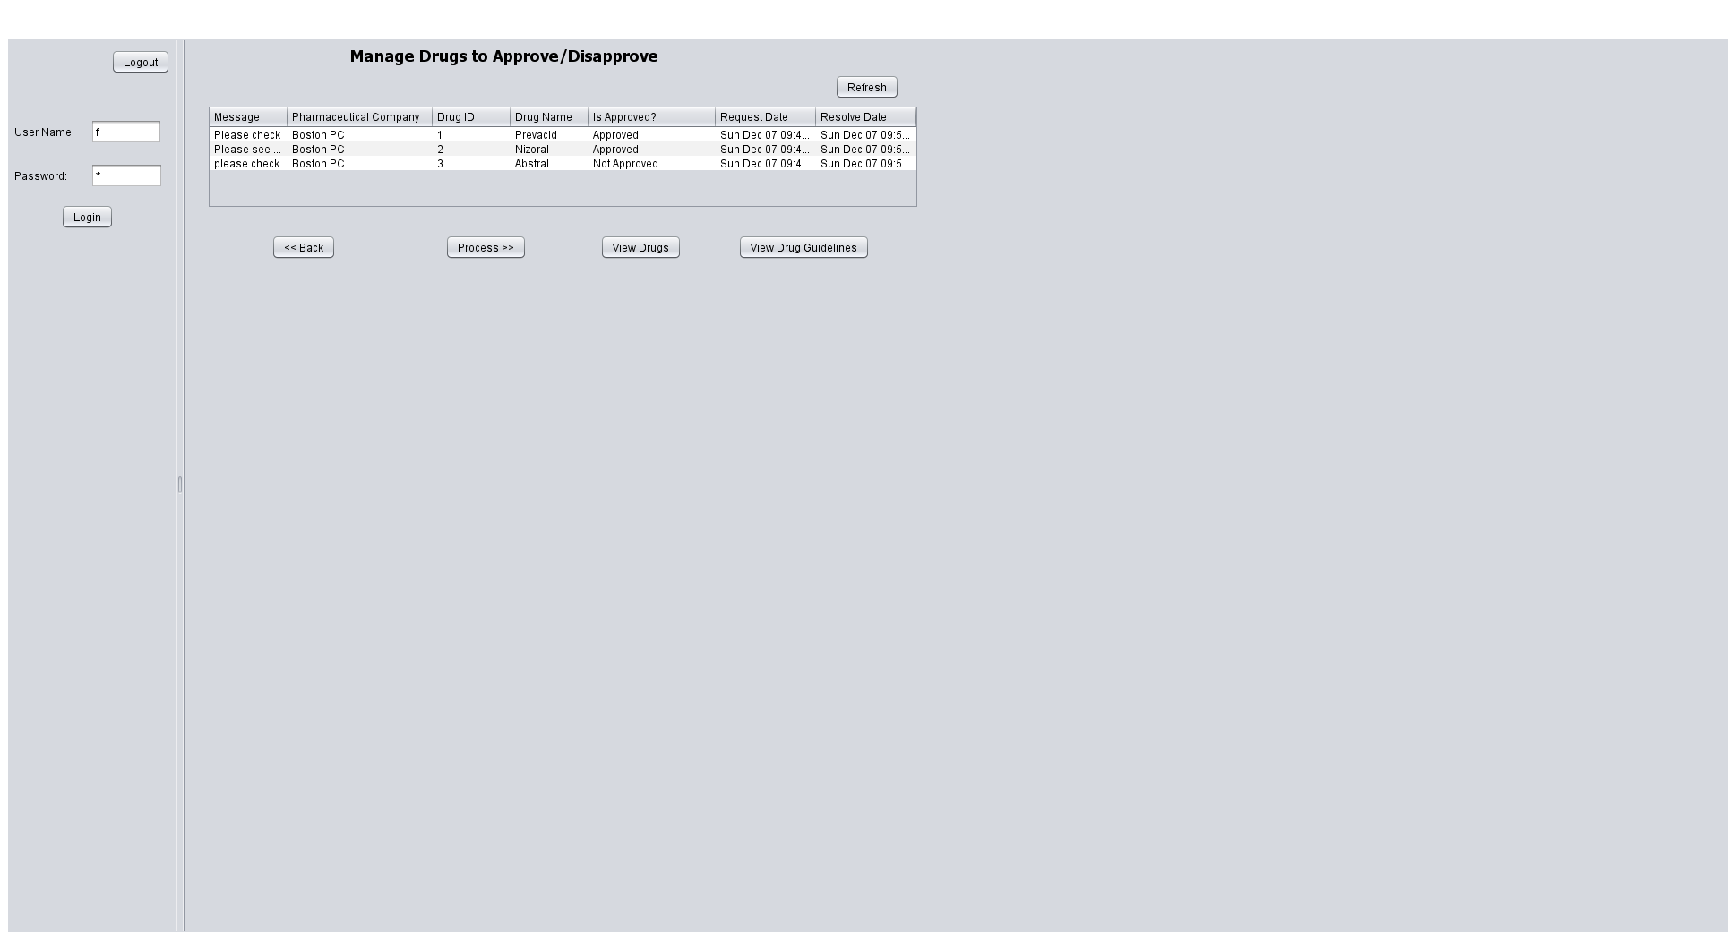
Manage drugs to approve/disapprove
After adding drugs by Pharmaceutical Company employee, the request to approve/disapprove drug is sent to FDA. It process the request by selecting either approved or disapproved.

Slide 7
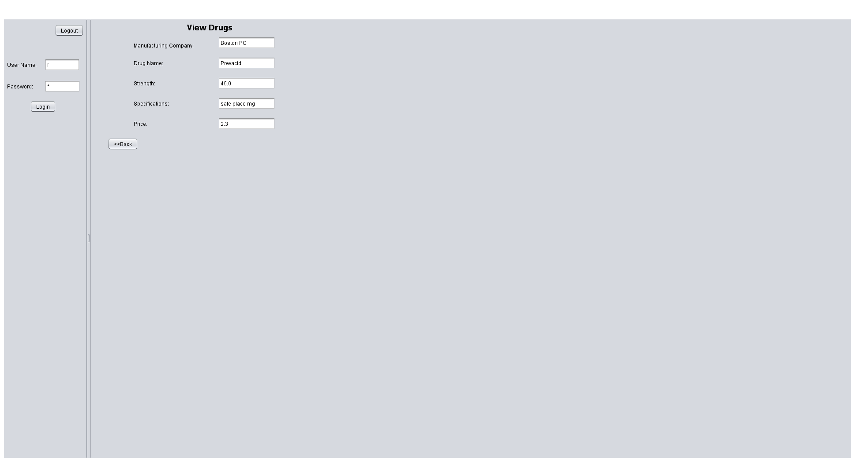
View Drugs by FDA
Drugs that has been added by Pharmaceutical Company Employee, can be seen by FDA.

Slide 8
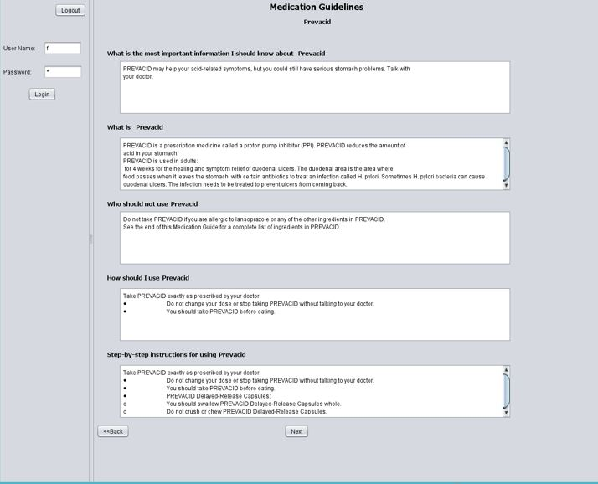
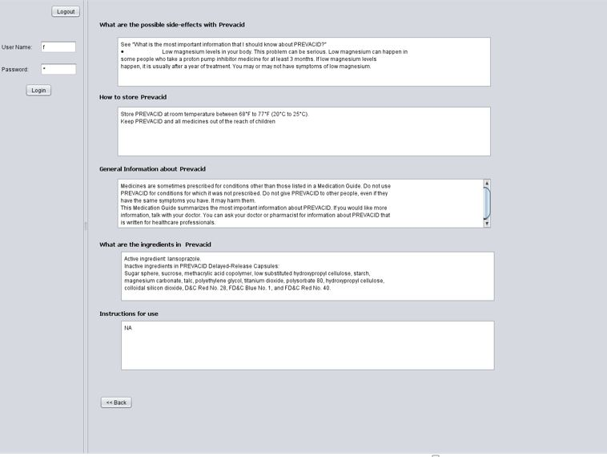
View Medication guidelines

Slide 9
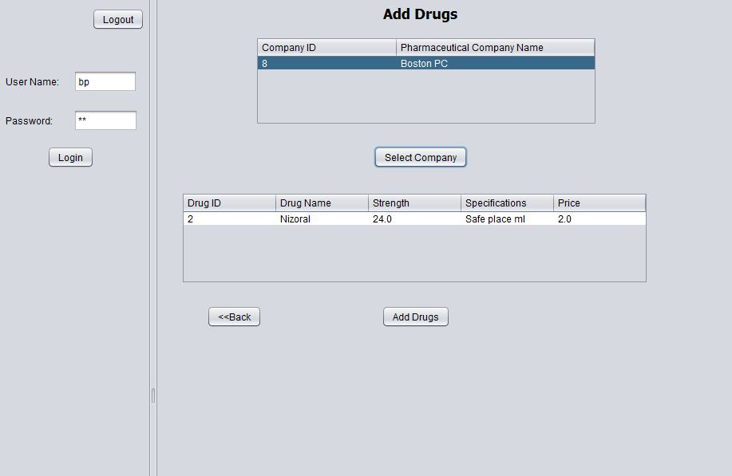
Pharmacies add drugs from Pharmaceutical Company

Slide 10
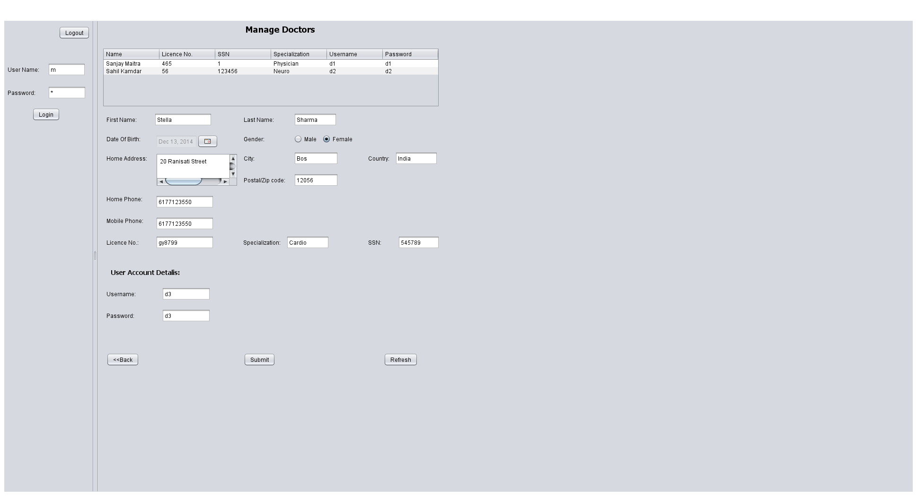
Admin of Board of Medicine adds doctors

Slide 11
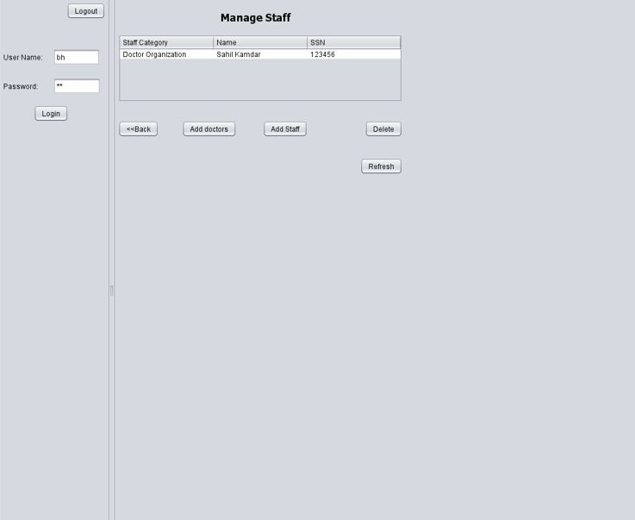
Hospital/Clinic add doctors

Slide 12
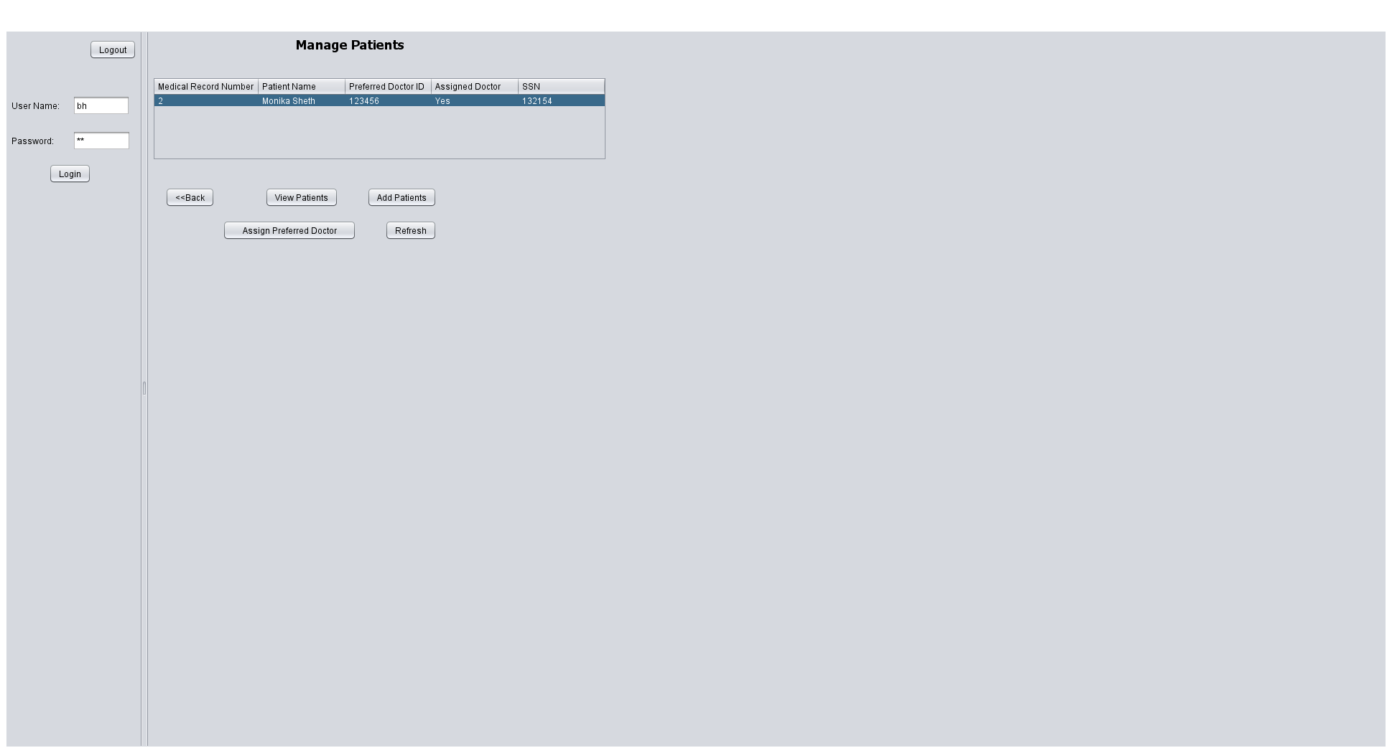
Assign Patient to Preferred Doctor
After adding patients,
Hospital/clinic admin
assigns to his preferred
doctor.

Slide 13
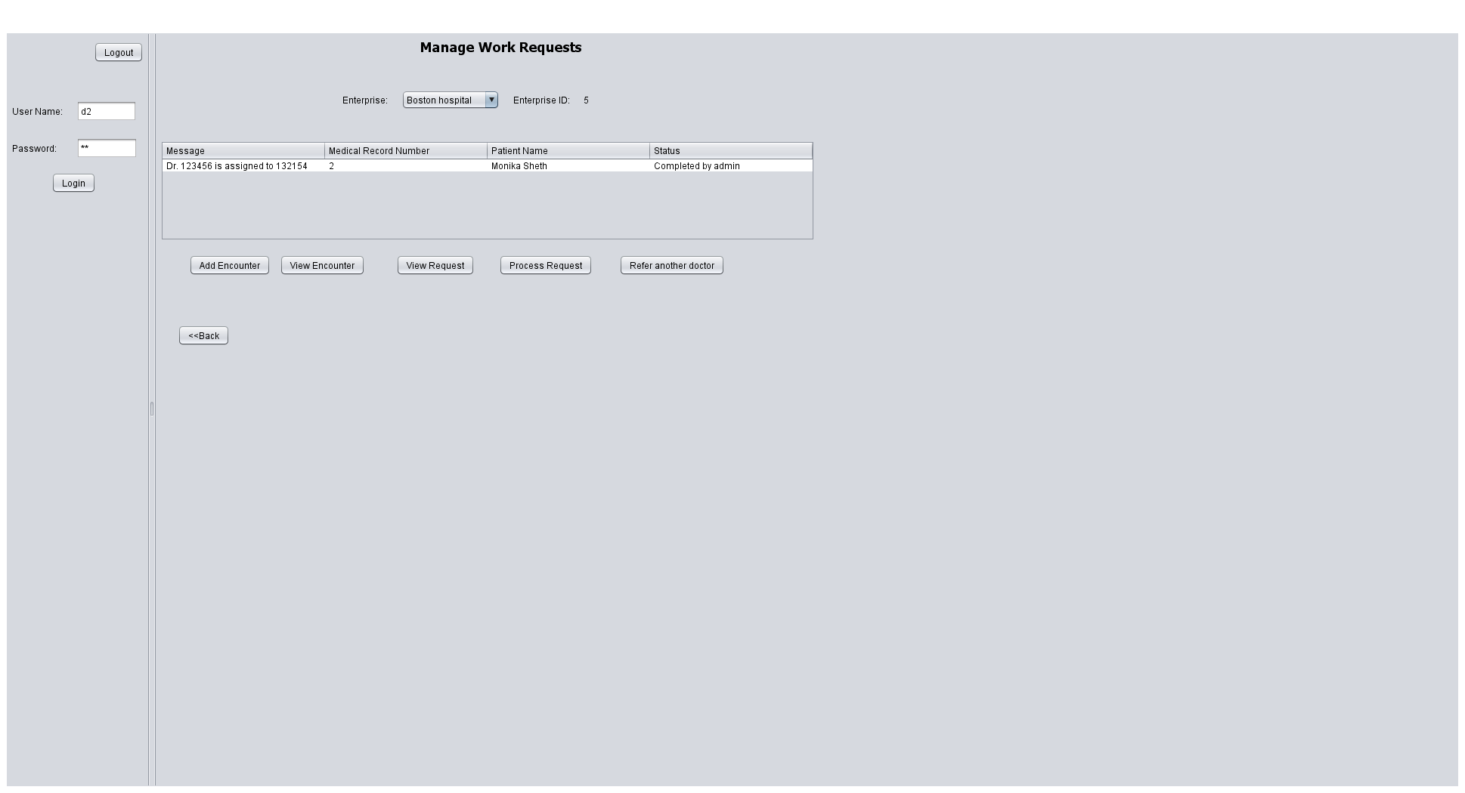
Manage work request of Doctors
After assigning a doctor
to patient, a work request
is added to the doctor

Slide 14
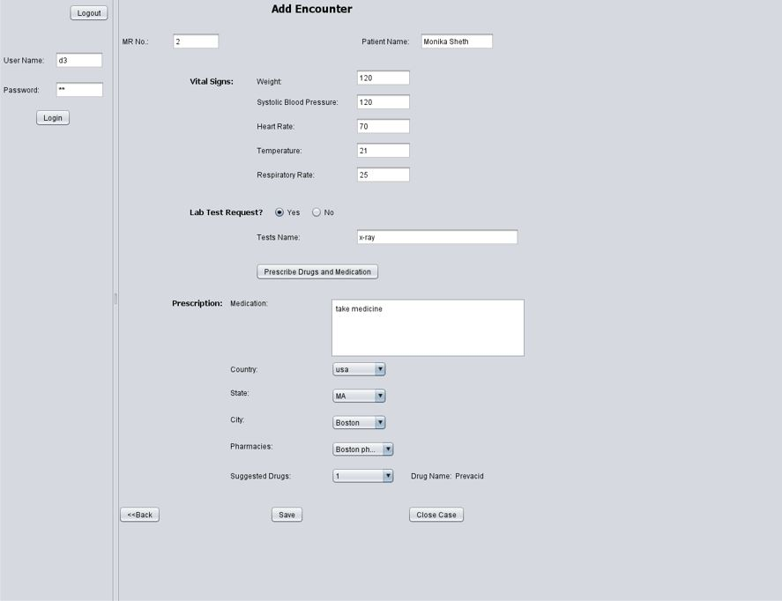
Add Encounter
Doctor adds an encounter
To the patient.

Slide 15
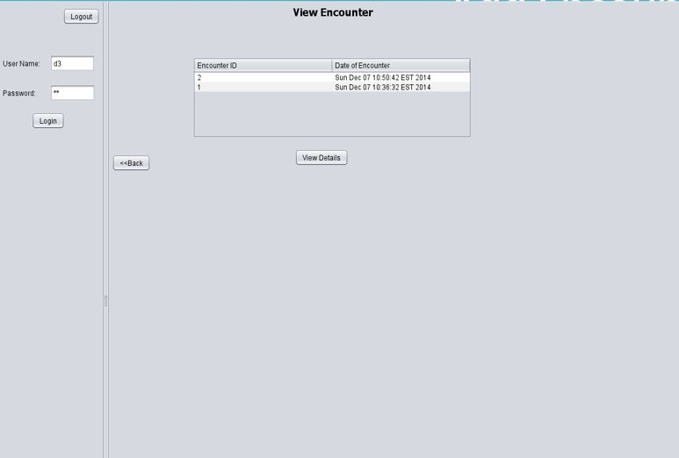
View Encounter

Slide 16
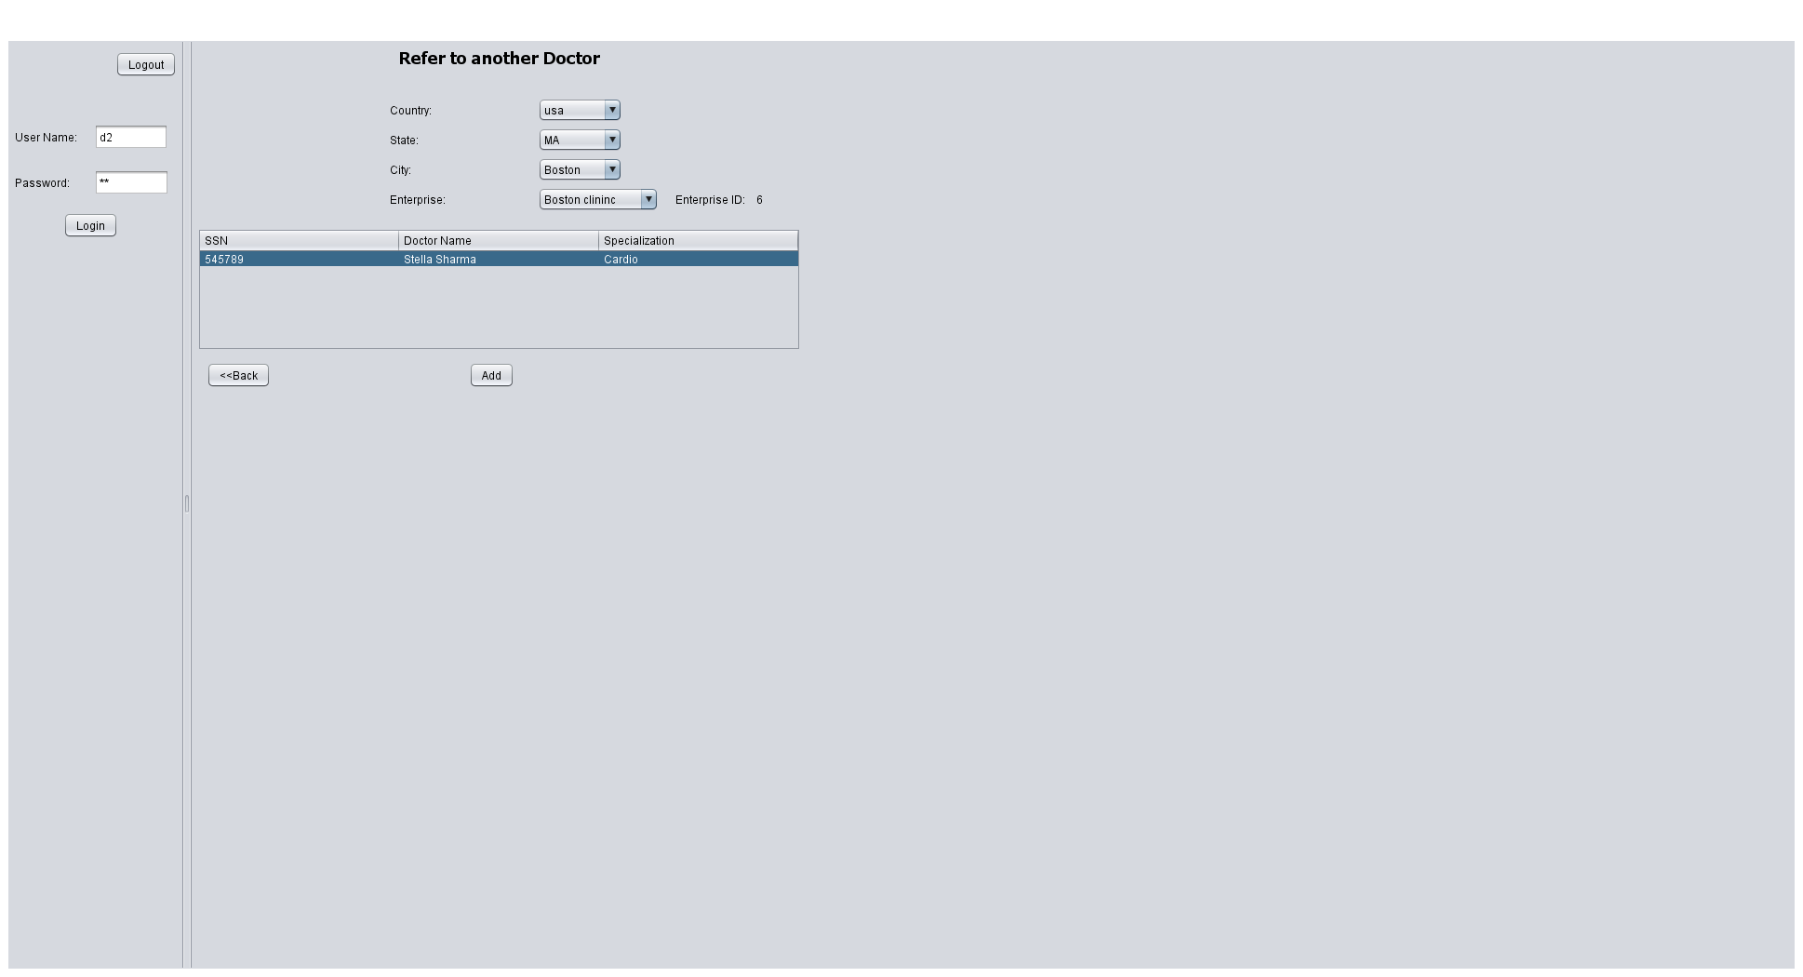
Preferred doctor refers another doctor to patient

Slide 17
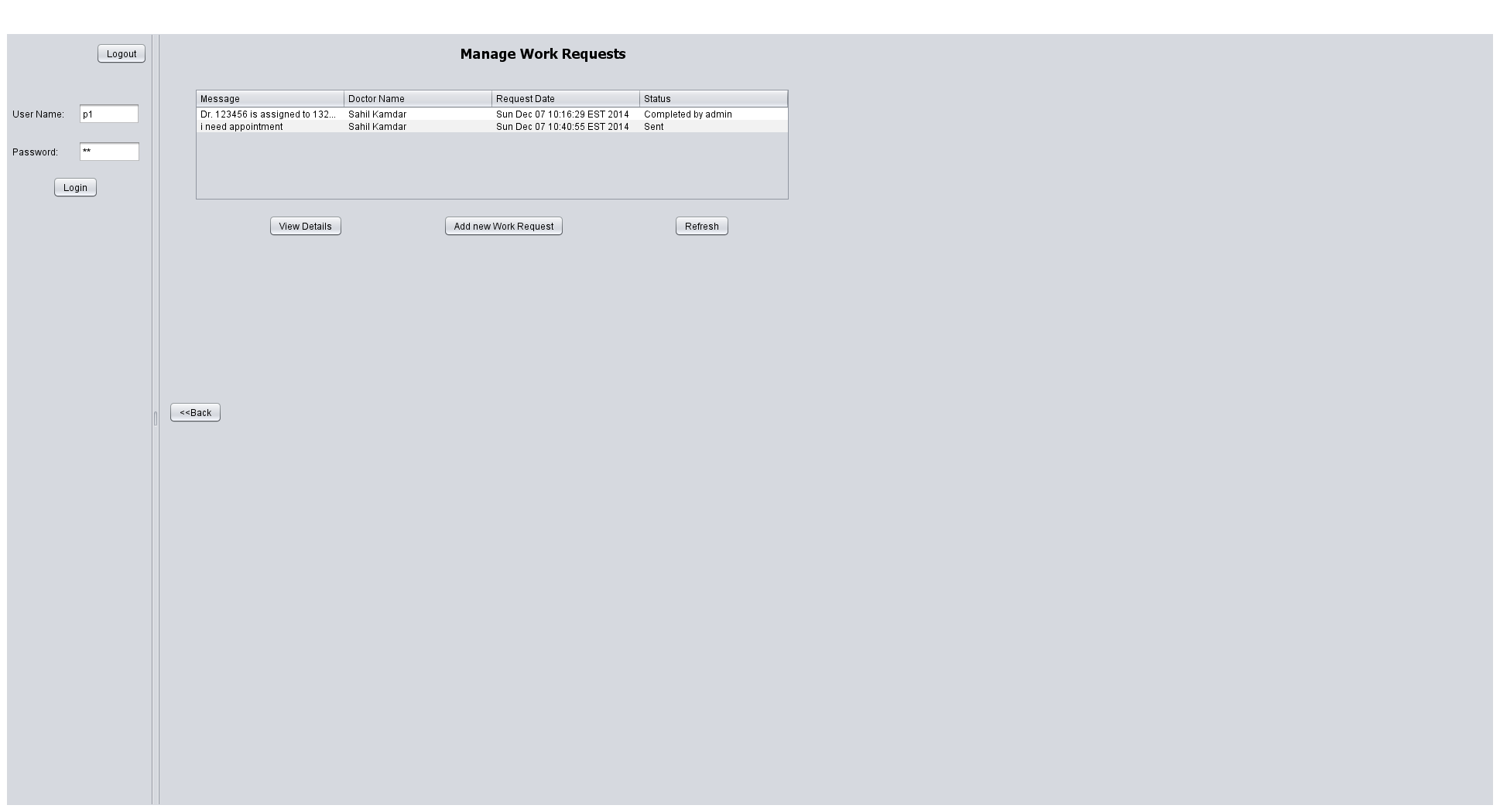
Manage work Request of Patients
Patients can see all his
Work request i.e. by hospital/ Clinic admin and by himself to
the doctor.

Slide 18
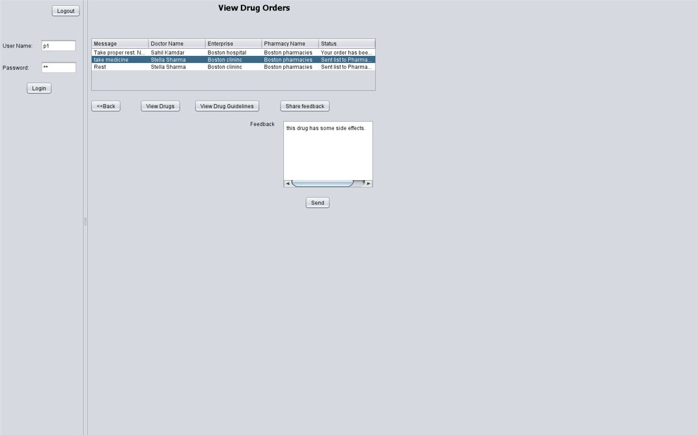
View drug order to patients
Patient can view the drug orders that were prescribed by doctor. Patient can also give feedback to Pharmaceutical company about Drugs

Slide 19
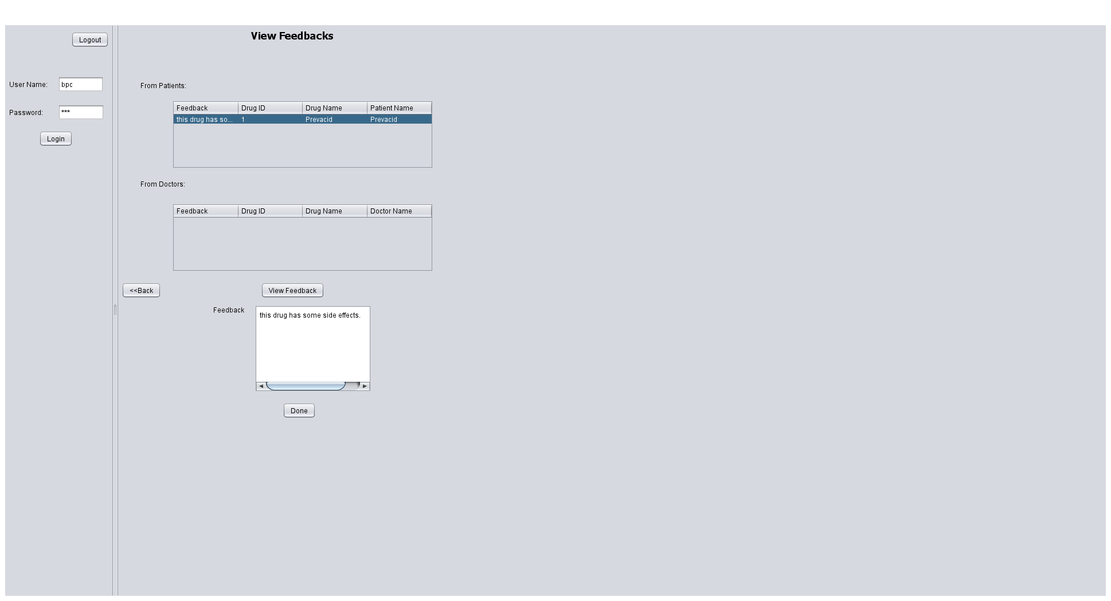
View feedback
Pharmaceutical company can view the feedback given by patients and doctors.

Slide 20
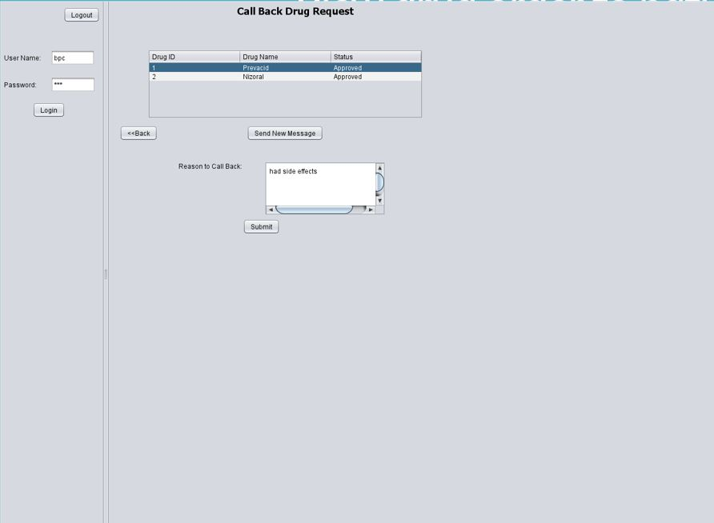
Call Back Request
Pharmaceutical company call back drugs from pharmacies.

Slide 21
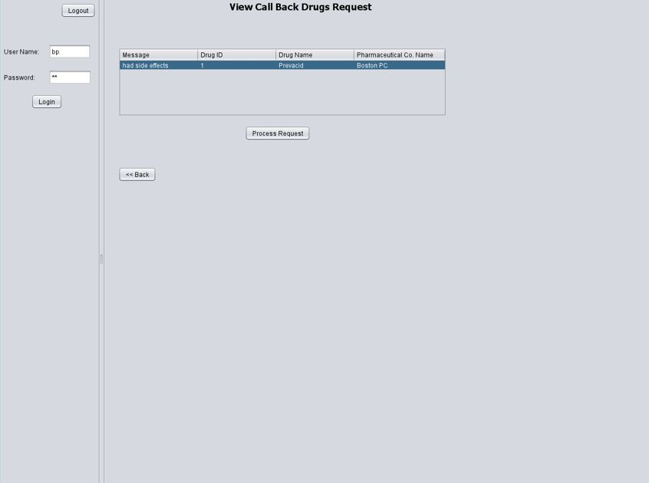
Call Back Request
Pharmacies can view and process this request.

Slide 22
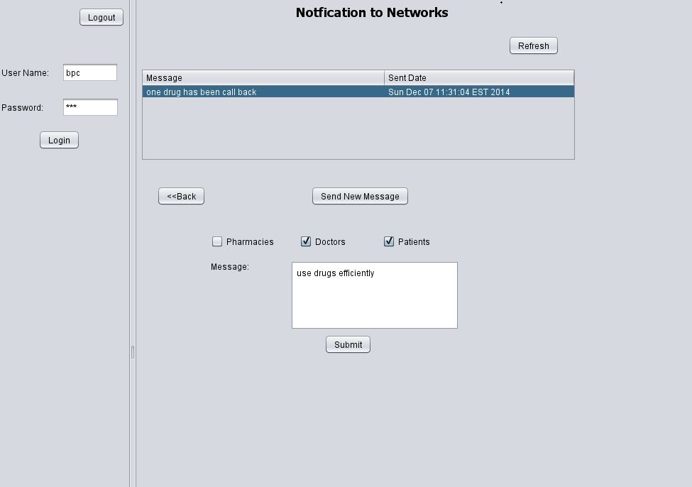
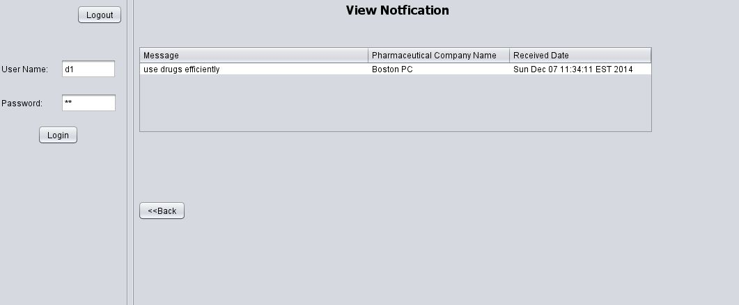
Notification
Pharmaceutical company can sends the notification
Here, doctor can see the notification from pharmaceutical company

Slide 23
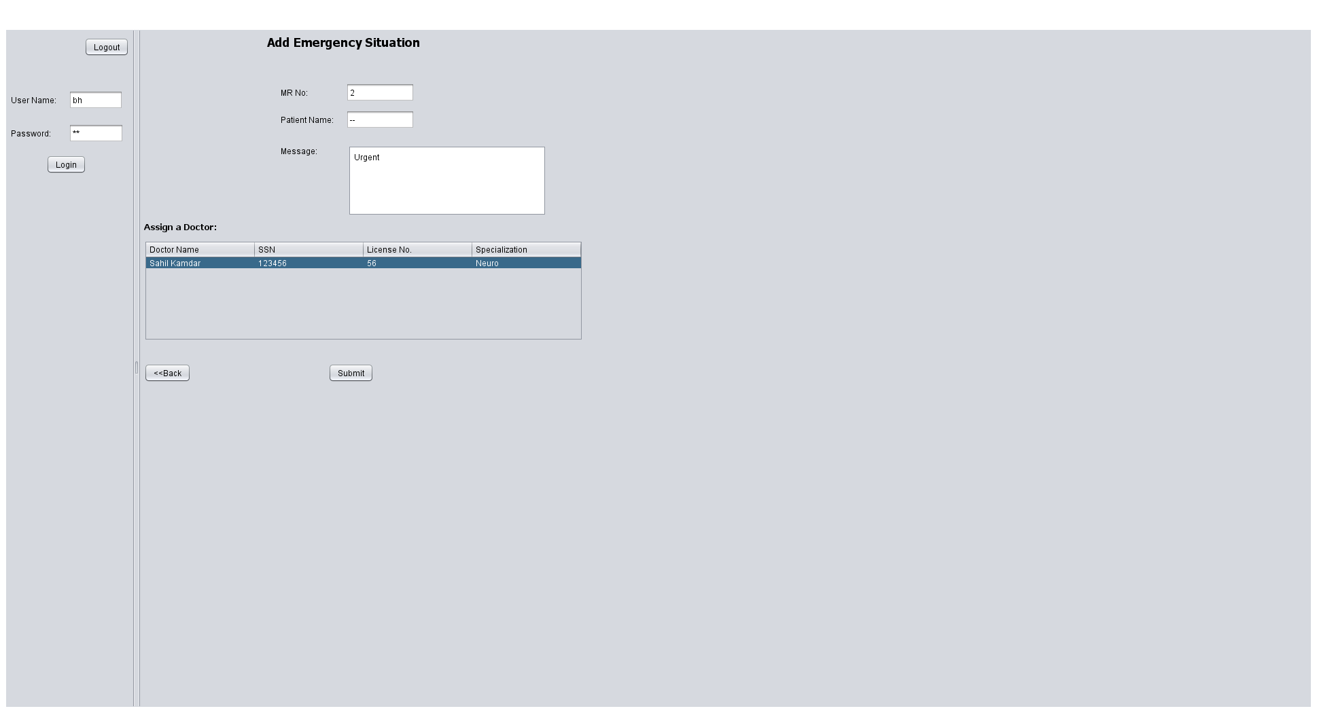
Add emergency situation of patient

Slide 24
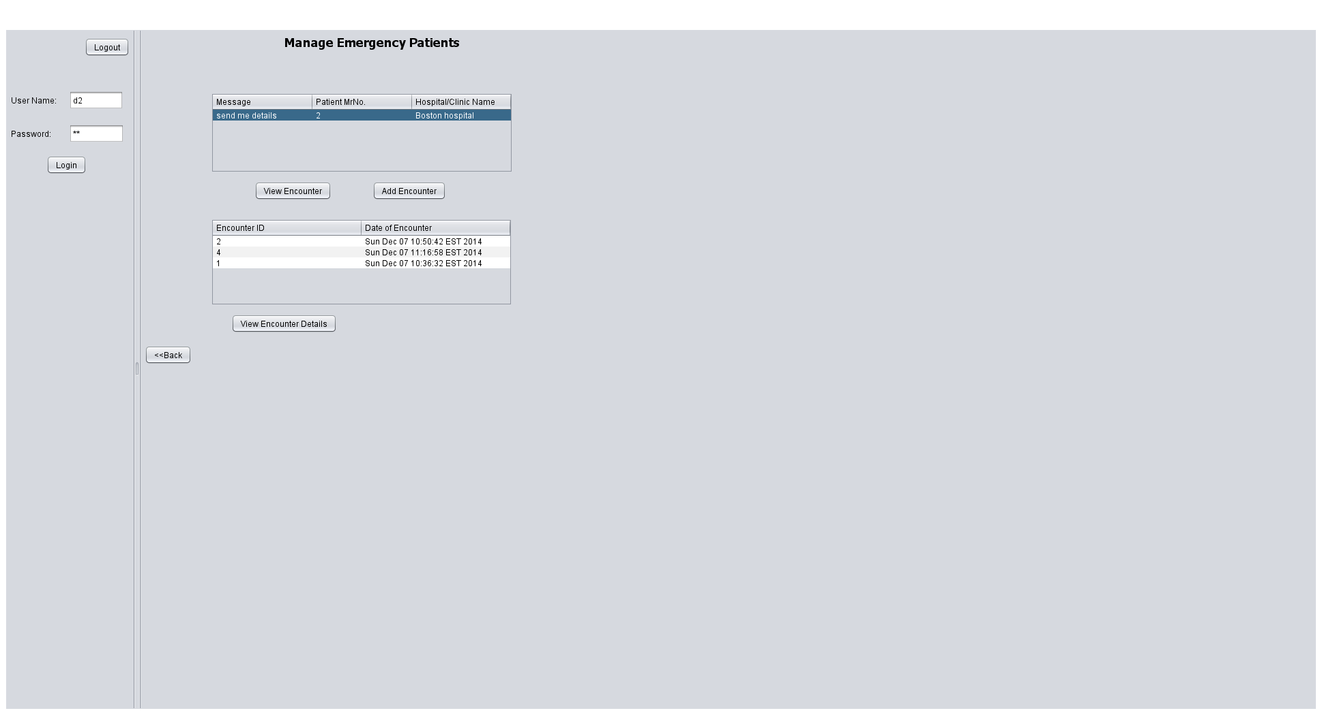
Manage emergency situation of patient

Slide 25
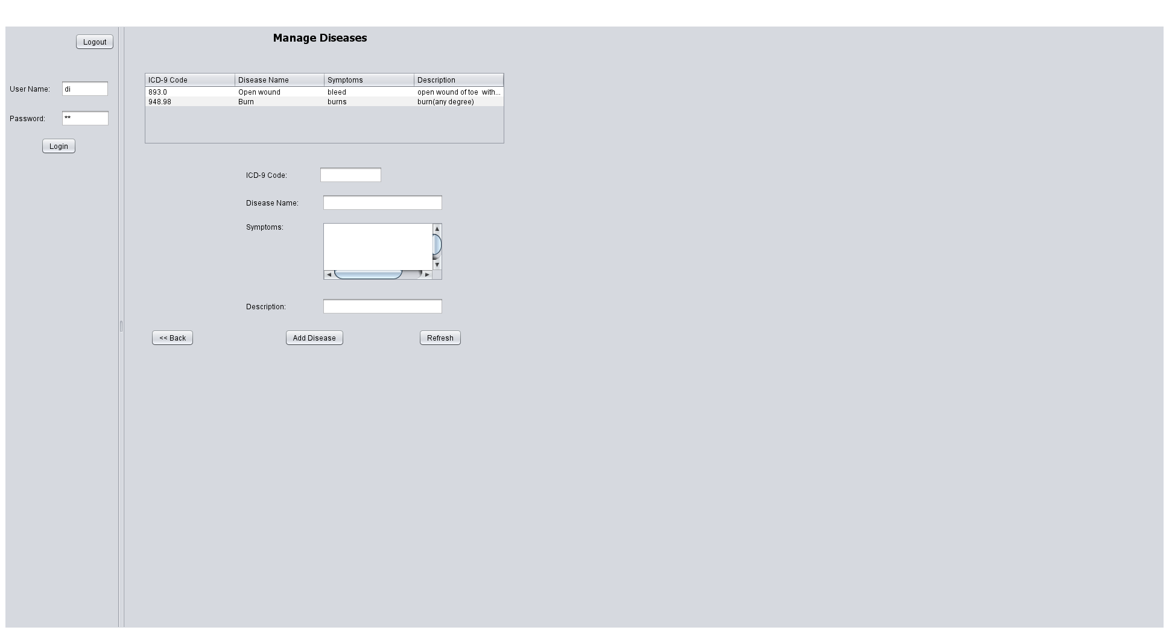
Add disease by an Admin

Slide 26
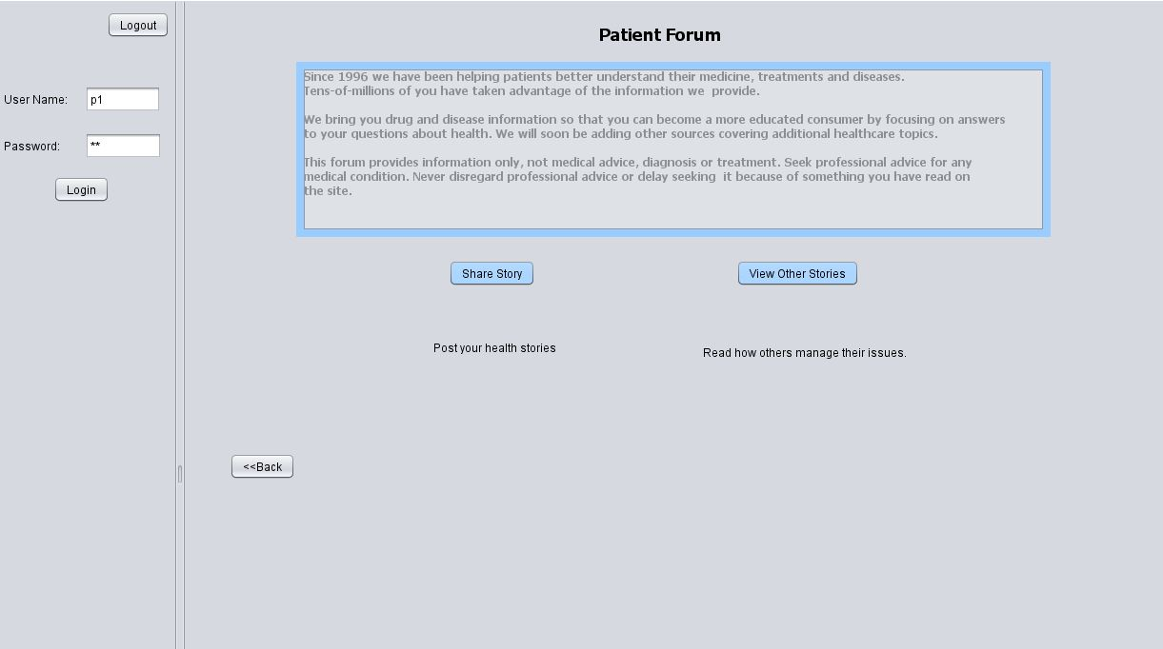
Patient Forum

Slide 27
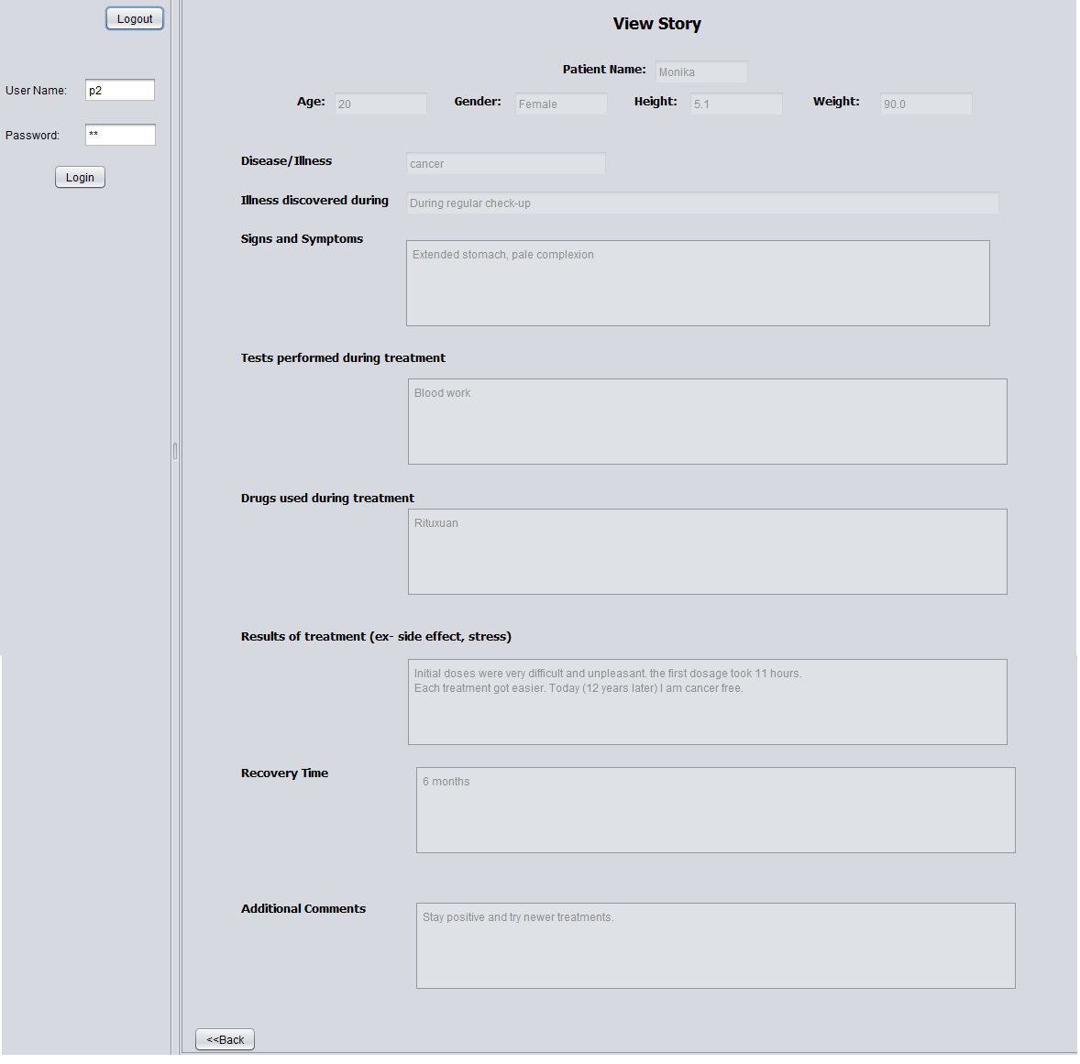
View Stories (experience) of other patients
by selecting a disease

Slide 28
Thank you!

